Slide 2
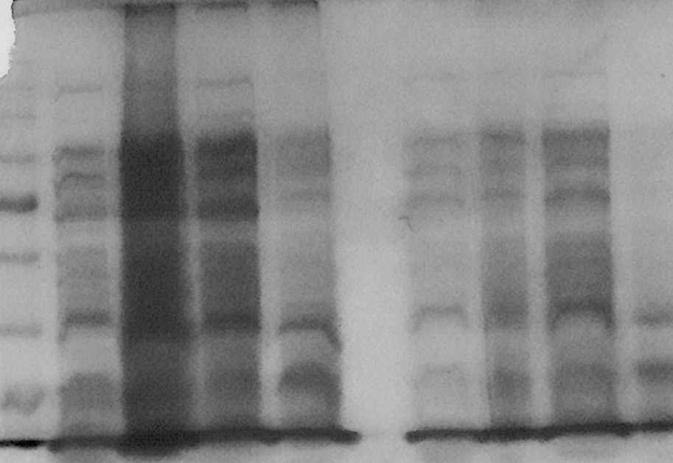
Ladder
Sample 7
Sample 3
Sample 6
Sample 8
Sample 1
Sample 4
Sample 5
Sample 2
KDa
100
80
58
46
32
25

